Slide 1
Communicating with Data
aka Storytelling

Slide 2
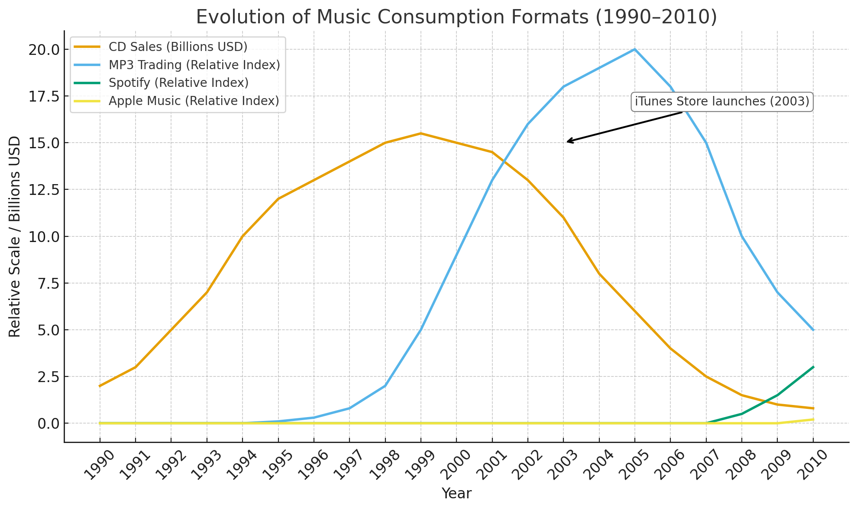
Disruption in the Music Industry
Notes:
This is here just to set the stage and provide some background to the class.
The MP3 audio format was standardized in 1993, but most listeners still used CDs.
By 1997–1998, a few artists and labels began posting MP3s online, but bandwidth limits kept audiences small.
The real disruption began in June 1999 with the launch of Napster, a peer-to-peer (P2P) file-sharing service that let millions of users trade MP3s freely.
Within a year, tens of millions of songs were being shared, and CD sales peaked in 2000 before beginning a sharp decline.
Apple’s iTunes Store launched in April 2003, offering legal downloads for $0.99 per song.

Slide 3
SCQA
A way to organize your thoughts and quickly and succinctly set the context for what you want to say
Situation: The background. A statement of ‘what is’. Sometimes the problem statement.
Complication: Why are we looking at this now? What has, or is going to, change?
Question: What were you tasked to do?
Answer: What did you find? What are you recommending?
Disruption in the music industry – Imagine it is 2001. What is Sony going to do?
The MP3 audio format was standardized in 1993, but most listeners still used CDs. By 1997–1998, a few artists and labels began posting MP3s online, but bandwidth limits kept audiences small. In June 1999 with the launch of Napster, a peer-to-peer (P2P) file-sharing service, millions of users could easily trade MP3s.
During the past year (2000) after a peak in 1999 of roughly $14–15 billion in U.S. revenue, CD sales began to fall. At the current rate sales will decrease by more than half within a decade and shatter the industry business model of recorded-music commerce.
Situation
Complication

Slide 4
Sample 1 – Music Industry Disruption Short and concise

Slide 5
You work for Sony. It is the Year 2001
The MP3 audio format was standardized in 1993, but most listeners still used CDs. By 1997–1998, a few artists and labels began posting MP3s online, but bandwidth limits kept audiences small. In June 1999 with the launch of Napster, a peer-to-peer (P2P) file-sharing service, millions of users could easily trade MP3s.
During the past year (2000) after a peak in 1999 of roughly $14–15 billion in U.S. revenue, CD sales began to fall. At the current rate sales will decrease by more than half within a decade and shatter the industry business model of recorded-music commerce.
Notes:
We have to pretend we are Sony in 2001 and panicking over the drop in CD sales.

Slide 6
Sample 2 – Rural Hospitals Multiple slides for S,C & Q

Slide 7
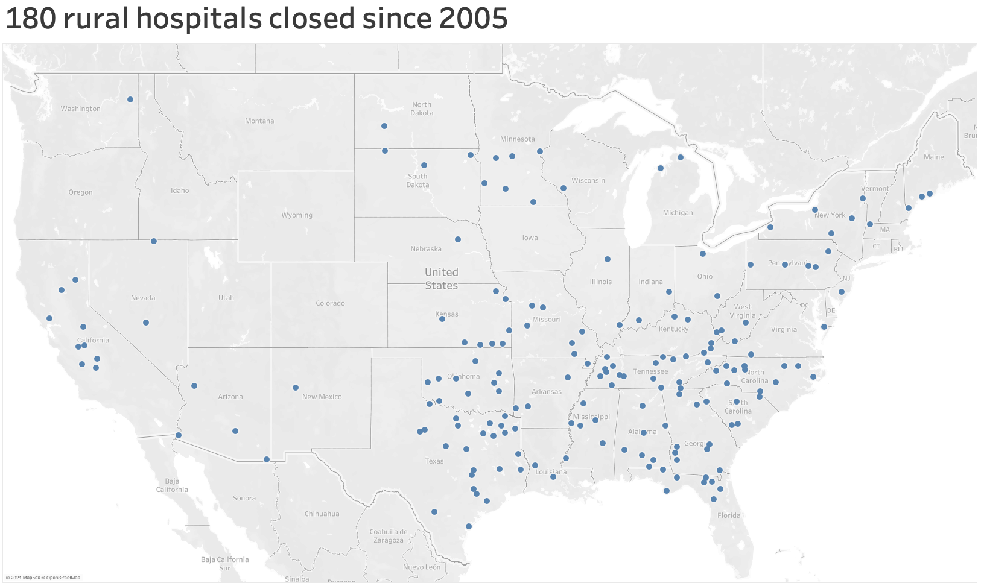
Since 2005 there have been 180 rural hospital closures
Situation
Notes:
Just an example where S, C and Q are on separate slides.

Slide 8
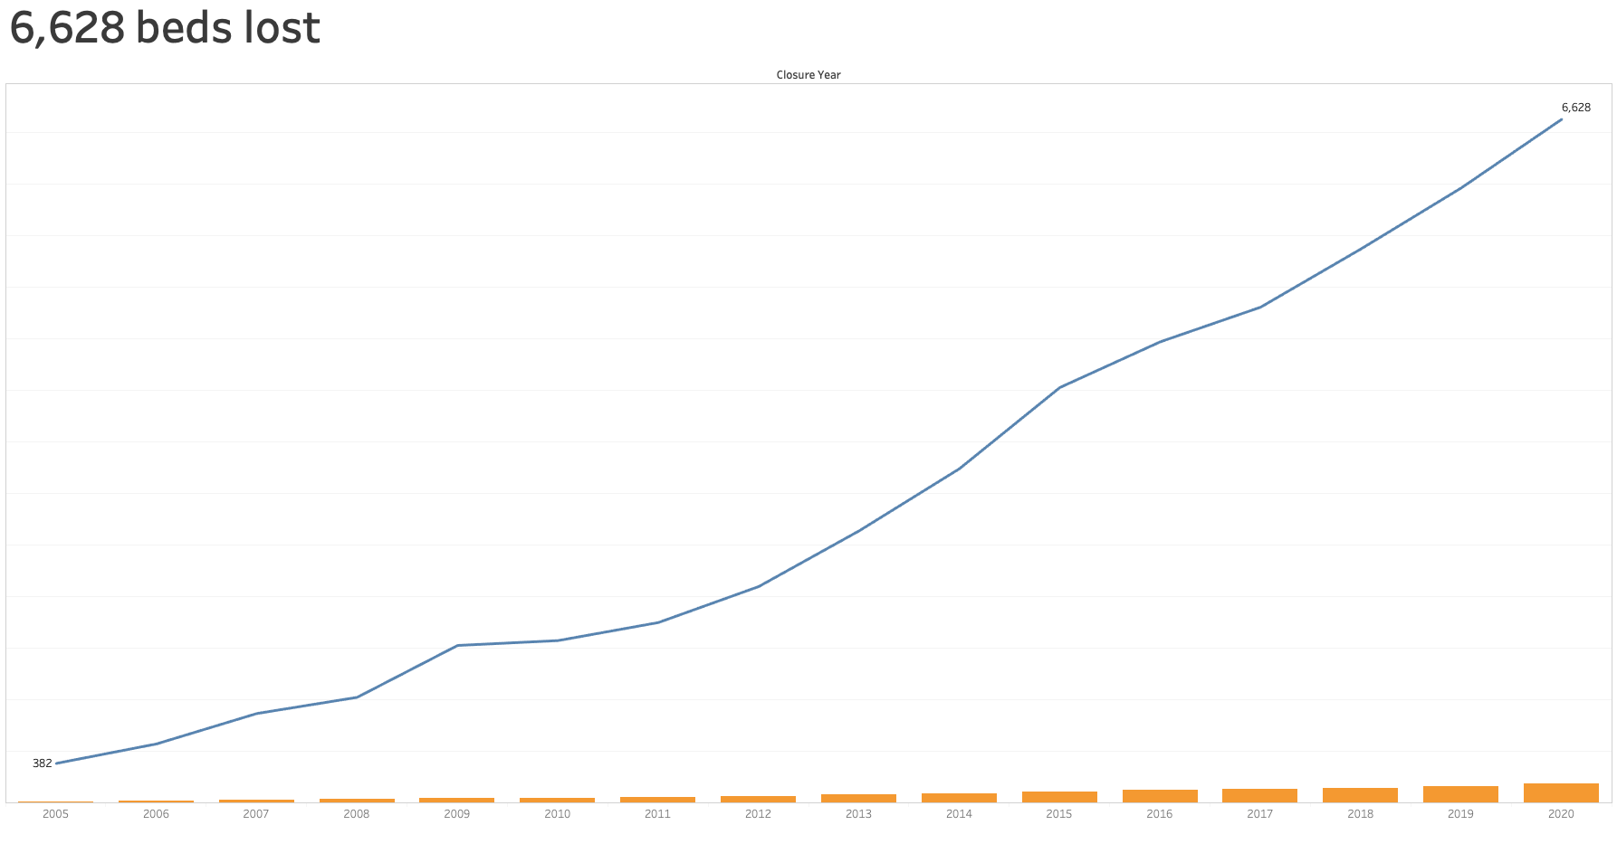
Over the last 8 years the rate of bed loss has increased
Complication

Slide 9
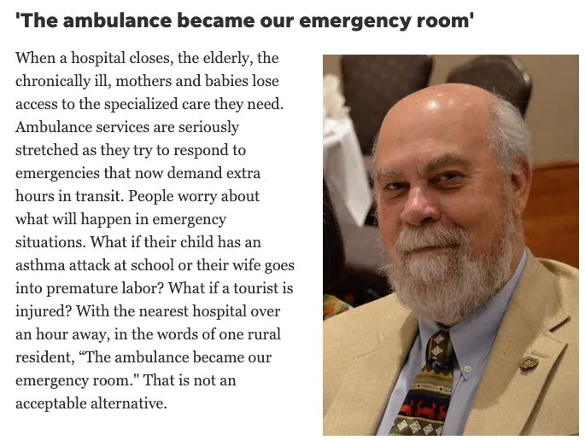
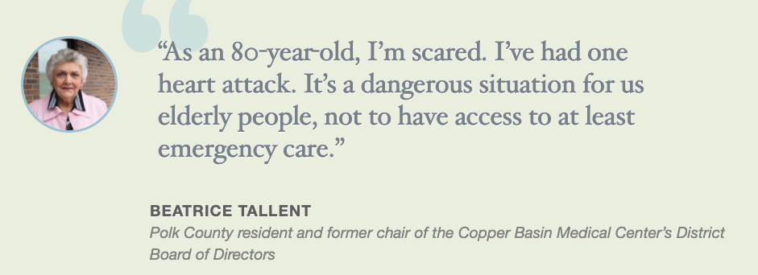
What is the impact on residents in rural areas?
No facilities, no qualified medical staff
Question
It isn’t a mystery novel.
Report your findings and then show the supporting data and other related interesting facts.

Slide 10
Our Omni-channel Diagnosis

Slide 11
There is a 23% gap between the number of omni-channel customers and our target
The organization is currently carrying out several projects to increase flat in-store sales and reverse declining digital sales.
Limited visibility into how channels impacts sales and customer experiences has masked a gap between the number of customers that are omni-channel (52%) and the target (75%)
Notes:
Situation: The organization is currently carrying out several projects to increase flat in-store sales and reverse declining digital sales.
Complication: Limited visibility into how channels impacts sales and customer experiences has masked a gap between the number of customers that are omni-channel (52%) and the target (75%)

Slide 12
Question – what are the root causes?
There are several places to look.
People, product, process, price, place, promotion, platform
Fragmented customer experience across channels
Limited mobile app adoption and engagement
Insufficient staff training and in-store technology
Weak incentive structure for cross-channel behavior
Poor data integration and personalization gaps
Which channels act as ’dead ends’ rather than bridges to other channels?
Notes:
For class, we are just talking about one sub-question. Which channels act as ‘dead ends’ and which are bridges to other channels.

Slide 13
Going from the work we did to presenting
This slide is not part of the presentation. It is here to show you how we were thinking about getting the data we needed
Channel level of use
Channel appearance in omni-channel
Create underutilization score
What channel combinations are most/least common
1
2
3
4
Touchpoint engagement by channel
Channels with high abandonment rates
Underutilization summary
Which channel pairs are rarely connected
5
6
7
8
Notes:
This slide and the next 2 are here to provide background to students. They would not be part of the presentation.

Slide 14
Which channels act as ’dead ends’ rather than bridges to other channels?
These are our answers.
Channel level of use
Channel appearance in omni-channel
Create underutilization score
1
2
3
Problem channels
Touchpoint engagement by channel
6
5
Channels with high abandonment rates
Abandonment
What channel combinations are most/least common
Which channel pairs are rarely connected
4
8
Connection Gaps
Underutilization summary
7
Executive Summary
Notes:
This slide is to explain how we organized the results of our queries to answer the question.

Slide 15
Note
The Social channel in omnichannel retail refers to social media platforms used for commerce and customer engagement. This includes site such as:
Shopping-Enabled Networks
Instagram - Shoppable posts, Stories, Instagram Shop, product tags
Facebook - Facebook Shops, Marketplace, shoppable ads
Pinterest - Product Rich Pins, Shopping ads, Try-on features
TikTok - TikTok Shop, Live shopping, shoppable videos
YouTube - Shoppable videos, product shelves

Slide 16
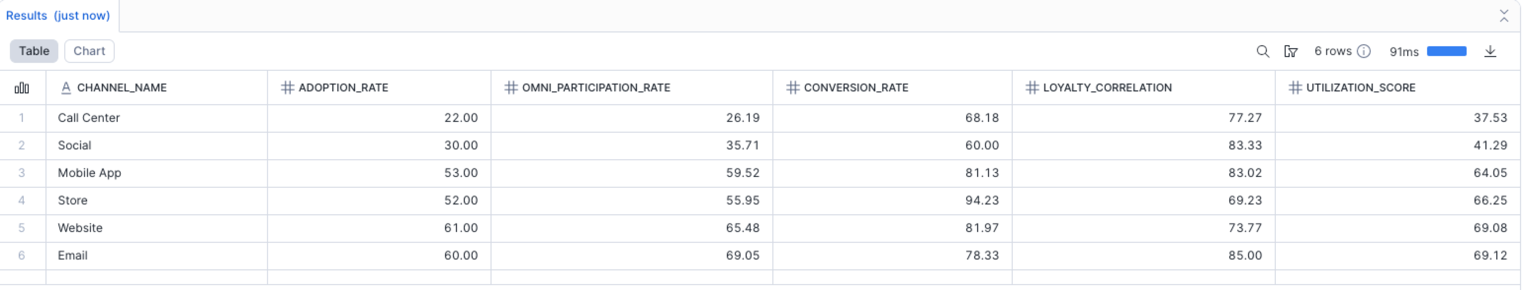
Answer/Argument 1: Problem Channels
Call Centers and Social are laggards in Omni-channel Journeys
Underutilization score (lower = more underutilized)
Calculations using total users and total customers were weighted for adoption and omni participation.

Slide 17
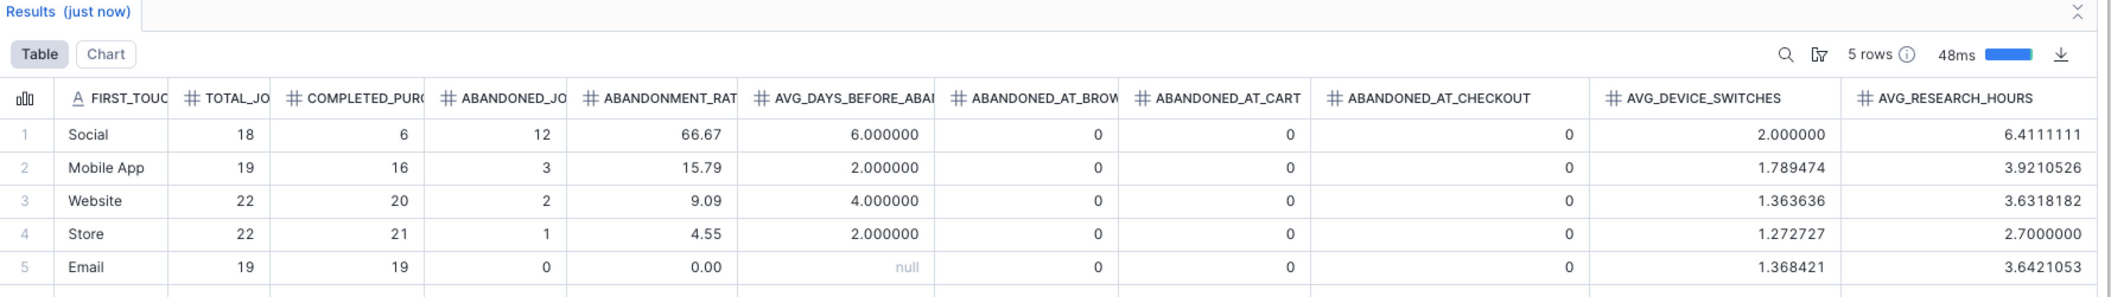
Answer/Argument 2: Abandonment
Social’s high abandonment rate indicates a friction point between it and other channels.

Slide 18
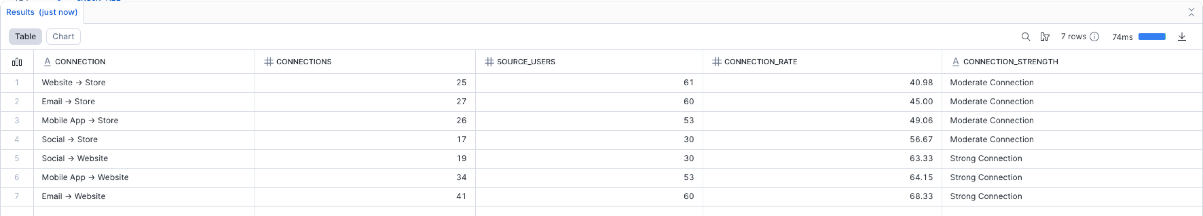
Answer/Argument 3: Connection Gaps
There is a need to improve all connections. Even ‘strong’ connections are at the low end of the scale
Connection Rate = # Connections/# Source Users
Connection rate (Developed with SMEs)
< 20 THEN 'Critical Gap’
< 40 THEN 'Weak Connection’
< 60 THEN 'Moderate Connection’
> 60 THEN ‘Strong Connection’
Call center connections (not shown) are all ‘Critical’

Slide 19
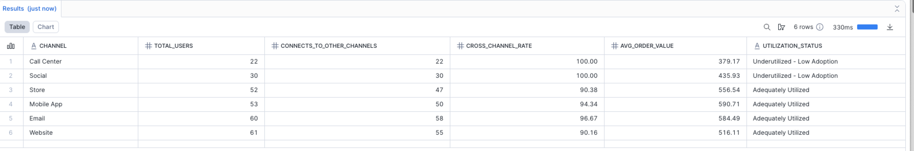
Summary
Store, Mobile App, Email and Website are common in omni-channel customers. The lower-than-expected utilization of d Social and the Call Center is a factor not achieving our 75% target

